Slide 1

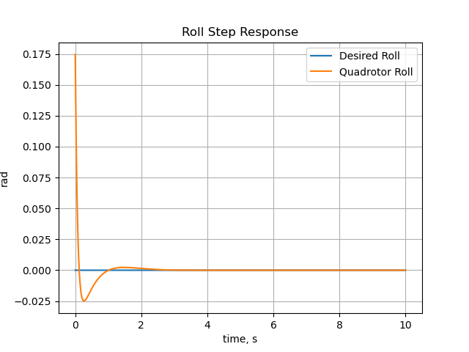
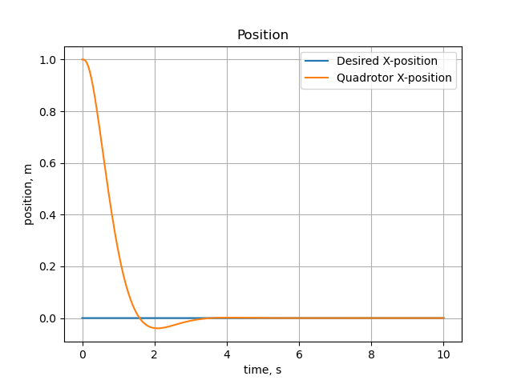
Looking at both Figures 1 and 2, it must be noted that the tuning processes turned out to be much more difficult than expected. The procedure for tuning involved tuning the z-position step response, followed by the yaw step, roll step , pitch step, x-position step, and y-position step respectively. Along the way, for each of the position step responses, care was taken to arbitrarily set the step response at 1.5 seconds to an average of 0.0467 and an average of response of 0.0036 at 0.2 seconds for the attitude step responses. However the figures at the right show that maintaining those results in the final tuned system were far from ideal.
Both Figures 1 and 2 appear to be underdamped, with zeta < 1 therefore the logarithmic decrement method can be used to estimate the damping ratios for both step responses. See Source 1 below. However given that the successive peak in each step response is vanishingly small, using this method will prove difficult by inspection, therefore we can safely estimate the damping ratio for each system to be between 0.4 and 0.7 according to known damping ratio plots (Source 2).
For settling time, typically defined as the time at which the system response reaches a 3% tolerance band. Therefore we see that for roll and x-position step responses, the settling time is vanishingly fast. More specifically we note that the system roll step system settles to equilibrium at t=2 whereas the x-position step settles at t=4.
Source1: https://en.wikipedia.org/wiki/Logarithmic_decrement
Source 2: https://en.wikipedia.org/wiki/Damping_ratio
Figure 1
Figure 2

